Slide 1
REGISTER TRANSFER AND MICROOPERATIONS
ABHISHEK KUMAR(2K19/CO/020)
ABHISHEK KUMAR Singh(2K19/CO/021)
ABHISHEK Sharma(2K19/CO/023)

Slide 2
Topics covered:
REGISTER TRANSFER LANGUAGE
SHIFT REGISTERS
ARITHMETIC MICRO-OPERATIONS

Slide 3
REGISTER TRANSFER LANGUAGE

Slide 4
REGISTER TRANSFER LANGUAGE
The symbol notation used to describe the microoperation transfer among register.
>> The use of symbols instead of a narrative explanation provides an organized and concise manner.
A convenient tool for describing the internal organization of digital computers in concise and precise manner.

Slide 5
REGISTER TRANSFER
REGISTER: Designated by capital Letter(sometimes followed by numerals):MAR(memory address register),PC(program counter),IR(instruction register),RI(processor register).
The numbering of bits in a 16 –bit register: marked on top of the box.
A 16-bit register partitioned into two parts:bit0- 7(symbol ”L” low byte), bit8-15 (symbol “H” high byte)

Slide 6
REGISTER TRANSFER
Information transfer from one register to another.
(transfer of the content of register R1 into register R2).
>>The content of the source register R1 does not change after the transfer

Slide 7
Basic symbols for register transfer:
Symbol
Letter and numerals
Parentheses()
Description
Denotes a register.
Example
MAR,R2
R2←R1
Arrow←
Comma,
Denotes a part of register.
Denotes transfer of information.
Separates two microoperation.
R2(0-7),R2(L)
R2←R1,R1,←R3

Slide 8
BUS AND MEMORY TRANSFER
BUS: If a computer has 16 register, each holding 32 bits. A bus is a single shared set of wires connecting all registers.

Slide 9
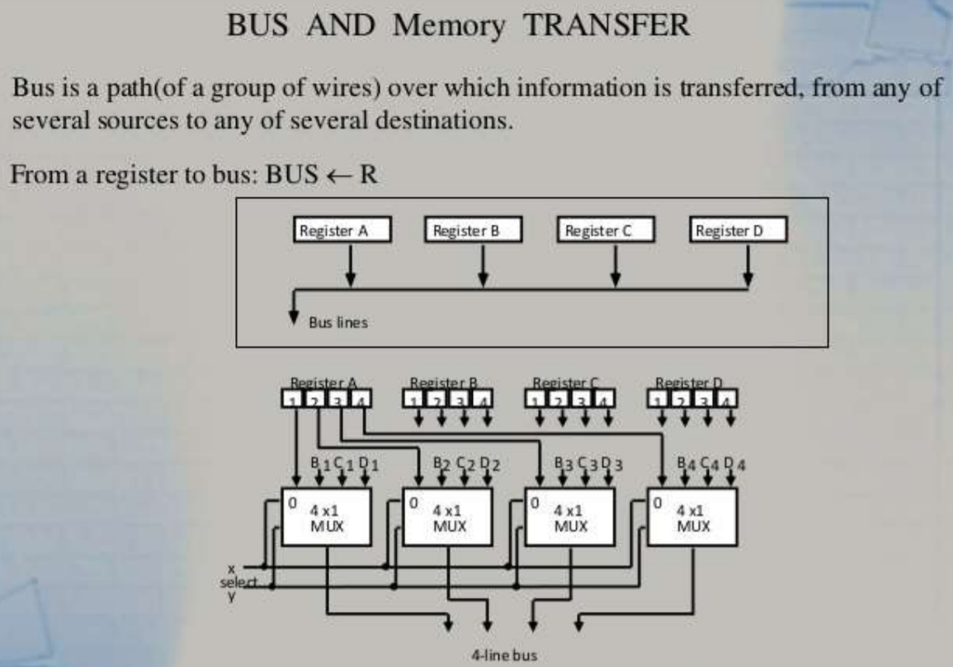

Slide 10
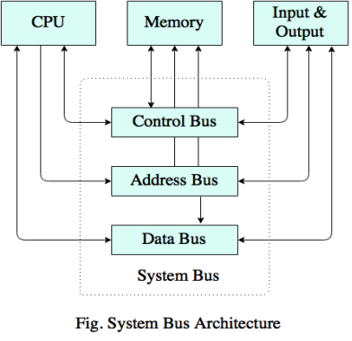

Slide 11
BUS TRANSFER IN RTL
Depending on whether the bus is to be mentioned explicitly or not, register transfer can be indicated as either
R2←R1 or
BUS←R1,R2←BUS
In the former case the bus is implicit ,but in the latter, it is explicitly indicated.

Slide 12
MEMORY TRANSFER
Collectively, the memory is viewed at the register level as a device.
Since it contains multiple locations, we must specify which address in memory we will be using.
This is done by indexing memory reference.
The memory address register(MAR or AR).

Slide 13
When memory is accessed , the contents of the MAR get sent to the memory unit’s address lines.
MEMORY
UNIT
AR
Read and write
Data out
Data in

Slide 14
Shift Registers

Slide 15
What is Shift Registers?
Flip flops can be used to store a single bit of binary data (1or 0). N flip flops are to be connected in an order to store n bits of data.
Register is a group of flip flops connected in series used to store multiple bits of data.
The information stored within these registers can be transferred with the help of shift registers.
Shift Register is a group of flip flops used to store multiple bits of data. The bits stored in such registers can be made to move within the registers and in/out of the registers by applying clock pulses.
For example, in SR flip flop if the input is (0,0) the value in the flip flop remains unchanged, which acts as memory but if we apply clock plus and change its input, its value gets changed. This property is used in shift registers.

Slide 16
The registers which will shift the bits to left are called “Shift left registers”. The registers which will shift the bits to right are called “Shift right registers”.
Shift registers are basically of 4 types. These are:
Serial In Serial Out shift register
Serial In parallel Out shift register
Parallel In Serial Out shift register
Parallel In parallel Out shift register
Shift right registers
Flip flop1
Flip flop2
Flip flop3
Flip flop4
Data input
Shift left registers

Slide 17
Serial-In Serial-Out Shift Register (SISO)
The shift register, which allows serial input and produces a serial output is known as Serial-In Serial-Out shift register.
The logic circuit given above shows a serial-in serial-out shift register. The circuit consists of four D flip-flops which are connected in a serial manner.
All these flip-flops are synchronous with each other since the same clock signal is applied to each flip flop.

Slide 18
Serial-In Parallel-Out shift Register (SIPO)
The shift register, which allows serial input and produces a parallel output is known as Serial-In Parallel-Out shift register.
The logic circuit given shows a serial-in-parallel-out shift register. The circuit consists of four D flip-flops which are connected.
The clear (CLR) signal is connected in addition to the clock signal to all the 4 flip flops in order to RESET them. The output of the first flip flop is connected to the input of the next flip flop and so on. All these flip-flops are synchronous with each other since the same clock signal is applied to each flip flop.

Slide 19
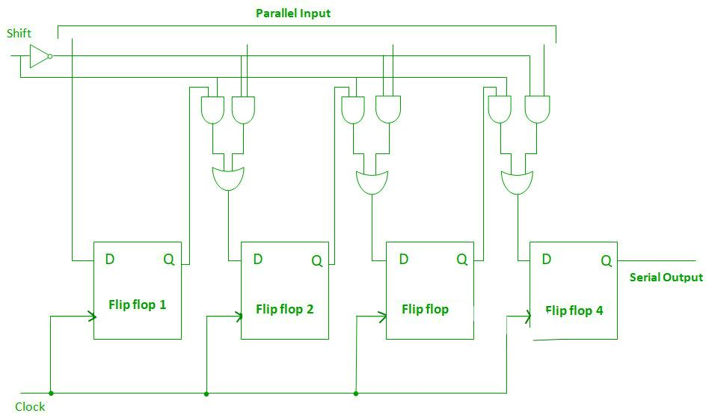
Parallel-In Serial-Out Shift Register (PISO)
The shift register, which allows parallel input and produces a serial output is known as Parallel-In Serial-Out shift register.
The clock input is directly connected to all the flip flops but the input data is connected individually to each flip flop through a multiplexer at the input of every flip flop.
The output of the previous flip flop and parallel data input are connected to the input of the MUX and the output of MUX is connected to the next flip flop.
All these flip-flops are synchronous with each other since the same clock signal is applied to each flip flop.
How PISO actually looks

Slide 20
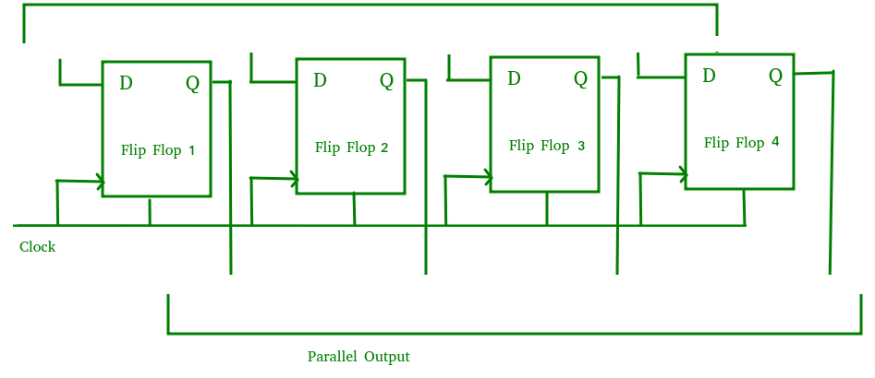
Parallel-In Parallel-Out Shift Register (PIPO)
The shift register, which allows parallel input and also produces a parallel output is known as Parallel-In parallel-Out shift register.
In this type of register, there are no interconnections between the individual flip-flops since no serial shifting of the data is required. Data is given as input separately for each flip flop and in the same way, output also collected individually from each flip flop.

Slide 21
Universal Shift Register
A Universal shift register is a register which has both the right shift and left shift with parallel load capabilities. Universal shift registers are used as memory elements in computers. A Unidirectional shift register is capable of shifting in only one direction.
A bidirectional shift register is capable of shifting in both the directions. The Universal shift register is a combination design of bidirectional shift register and a unidirectional shift register with parallel load provision.
n-bit universal shift register – A n-bit universal shift register consists of n flip-flops and n 4×1 multiplexers. All the n multiplexers share the same select lines(S1 and S0)to select the mode in which the shift register operates. The select inputs select the suitable input for the flip-flops.

Slide 22
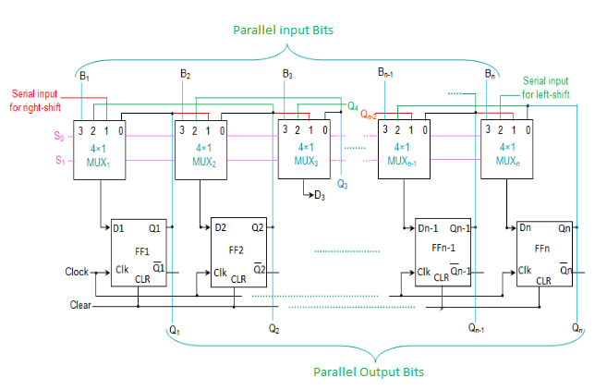
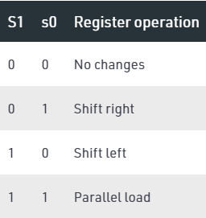
Basic connections –
The first input (zeroth pin of multiplexer) is connected to the output pin of the corresponding flip-flop.
The second input (first pin of multiplexer) is connected to the output of the very-previous flip flop which facilitates the right shift.
The third input (second pin of multiplexer) is connected to the output of the very-next flip-flop which facilitates the left shift.
The fourth input (third pin of multiplexer) is connected to the individual bits of the input data which facilitates parallel loading.

Slide 23
ARITHMETIC MICRO-OPERATIONS

Slide 24
ARITHMETIC MICRO-OPERATIONS
A micro-operation is an elementary operation performed with the data stored in registers. Arithmetic Micro-operations perform arithmetic operation on numeric data stored in registers.
The basic arithmetic micro operations are :-
Addition
Subtraction
Increment
Decrement

Slide 25
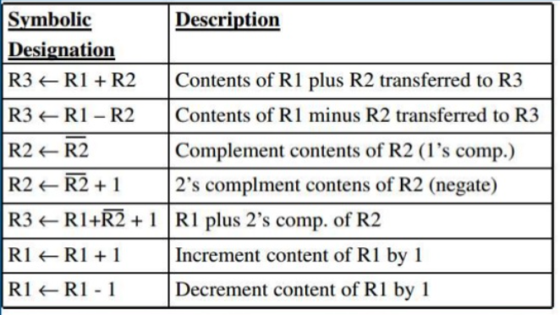


Slide 26

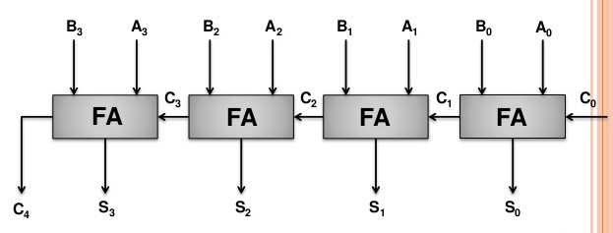

ADDITION MICRO-OPERATION
The arithmetic add micro operation is given by the statement,
It states that the contents of register R1 are added with the contents of register R2 and the result will be transferred to register R3.
4- bit Binary Adder

Slide 27
Working
Add Micro operation can be implemented using Full adders.
Each full adder takes 2 inputs from 2 numbers and a third input as a previous carry.
All the carries are connected in serial fashion to the next full adder.
Number of full adders depends upon number of bits of data.
When A₀ B₀ are added and initially C₀ is 0 then as a result S₀ gives the sum of A₀ and B₀ and so on.

Slide 28

ARITHMETIC MICRO-OPERATIONS
The arithmetic addition / subtraction micro operation is given by the statements,
The addition and subtraction operations are performed in one common circuit by including an exclusive-OR gate with each full adder.

Slide 29
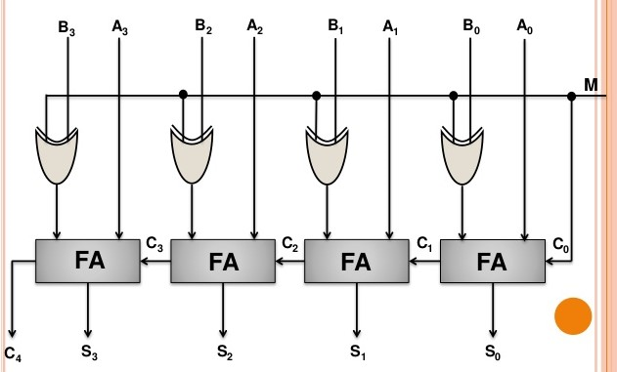
4- bit Adder - Subtractor

Slide 30
Working
The addition and subtraction operations can be combined into one common circuit by including an XOR gate with each full-adder.
With the help of a mode bit we can add or subtract.
M = 0
When M is 0 then C_{in} will be 0 and 0 B₀ gives B₀ then S₀ will be the sum of A₀ and B₀. Hence M = 0 will perform addition.
M = 1
When M is 1 then C_{in} will be 1 and 1 B₀ gives Bo then A₀ + B₀ + 1 = A₀ - B₀. Hence M = 1 will perform subtraction.

Slide 31

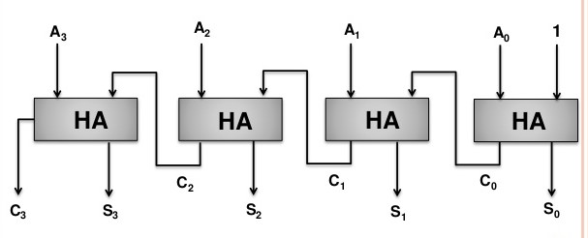
INCREMENT MICRO-OPERATION
The increment micro operation is given by the statement,
The contents of register R1 are incremented by one.
4- bit Binary Incrementer

Slide 32
Working
The increment Micro operation adds 1 to a number in a register.
This Micro operation easily carried out using half adders as described in previous slide.
Each half adder needs 1 input and 1 carry. In the very first half adder the carry is 1.
As this is the increment micro operation hence the carry is forward to the next half adder if generated and as a result sum bits S₃ , S₂ , S₁ , S₀ are generated along with a possible carry out.

Slide 33
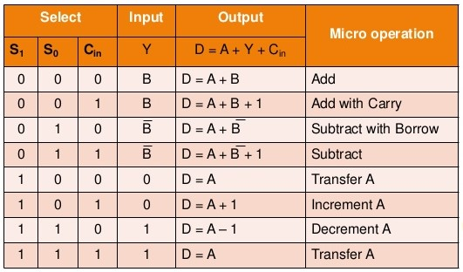
ARITHMETIC CIRCUIT
The basic arithmetic micro operations (addition, subtraction, increment and decrement) can be performed in one composite arithmetic circuit.

Slide 34
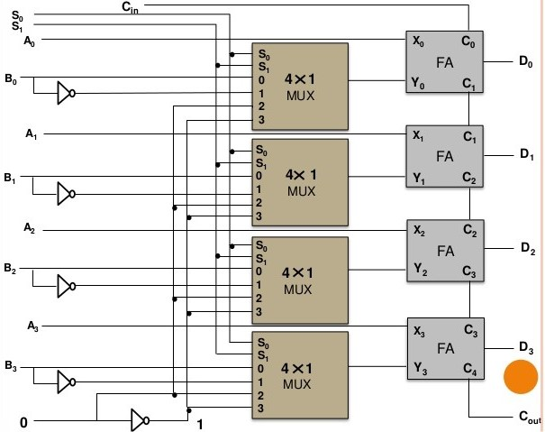
4- bit Arithmetic Circuit

Slide 35
Working
This arithmetic circuit can perform 8 operations. Microoperation D = A is generated twice, so there are only 7 distinct Microoperations in the arithmetic circuit. Among them some are :-
Addition
When S₁ S₀ = 0 0, the value of B is applied to the Y inputs of the adder. If C_{in} = 0, the output D = A + B. If C_{in} =1, output D = A + B + 1. Both cases perform the add micro-operation with or without adding the input carry.
Subtraction
When S₁ S₀ = 0 1, the value of B is applied to the Y inputs of the adder. If C_{in} = 1, then D = A + B + 1. This produces A plus the 2's complement of B, which is equivalent to a subtraction of A - B. When C_{in} = 0, then D = A + B. This is equivalent to a subtract with borrow, that is, A - B - 1.

Slide 36
Increment
When S₁ S₀ = 1 0, the inputs from B are neglected and instead, all 0's are inserted into the Y inputs. The output becomes D = A + 0 + C_{in}. This gives D = A when C_{in} = 0 and D = A + 1 when C C_{in} = 1. In the first case we have a direct transfer from the input A to output D while in the second case the value of A is incremented by 1.
Decrement
When S₁ S₀ = 1 1, all 1's are inserted into the Y inputs of the adder to produce the decrement operation D = A - 1 when C_{in} = 0. This is because a number with all 1's is equal to the 2's complement of 1 (the 2's complement of binary 0001 is 1111). Adding number A to the 2’s complement of 1 produces F = A + 2's complement of 1 = A – 1. When C_{in} = 1, then D = A - 1 + 1 = A, which causes a direct transfer from input A to output D.

Slide 37
THANK YOU
YOUR FEEDBACK IS IMPORTANT TO US

